Slide 1
What are the risk factors associated with occupational injuries?
Gideon Potgieter

Slide 2
Data Set and Design
The Quality of Worklife survey
Been in use since 1977, newest data set is from 2014
Primary predictor variable: Occupation
Outcome: Occupational injury in the past year
Confounders and effect modifiers: Age, sex, overall health

Slide 3
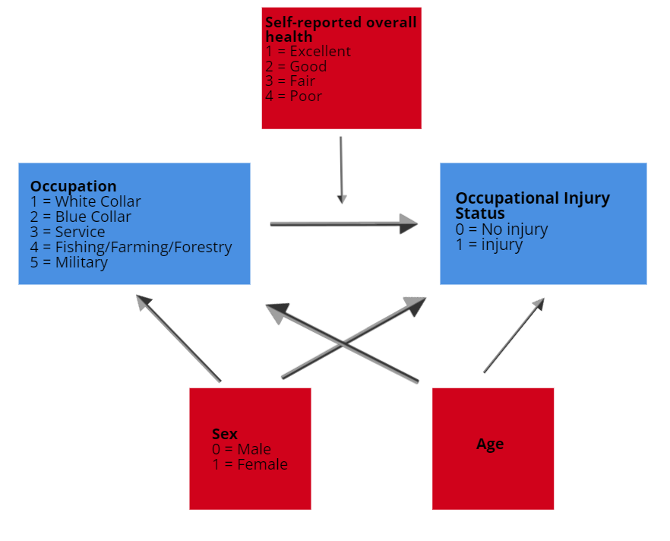
DAG

Slide 4
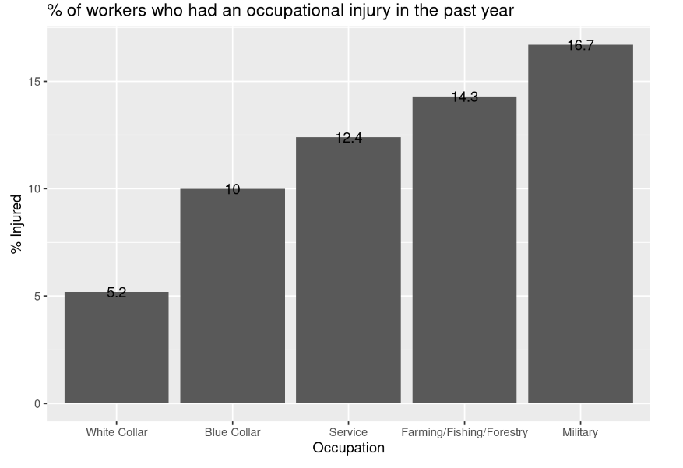

Slide 5
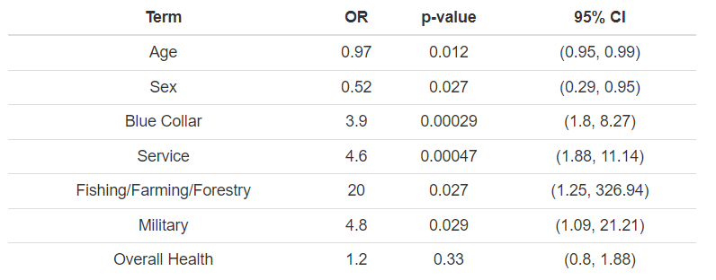
Survey Weighted Logistic Regression

